Slide 1

Book Recommendation System
Michael Nguyen

Slide 2




Why Recommendation System?
Business Case
Increases a company's short-term revenue but also supports customer satisfaction
In 2016, Netflix estimated that its recommendation is worth $1 billion per year in revenue
Netflix even held a competition in designing recommendation systems with a grand prize of $1 million
Customer

Slide 3
Why Recommendation System?
BUILD A RECOMMENDATION
SYSTEM ON BOOKS USING
COLLABORATIVE FILTERING
BASED ON USERS

Slide 4
Data Overview
Three datasets provided by Ruchi Bhatia on Kaggle
BX-Books
contains information about the books
columns: ISBN, Book-Title, Book-Authors etc.
BX-Users
contains information about the users
columns: User-ID, Location, Age
Merge using ISBN
Merge using User-ID
BX-Book-Ratings
contains information on ratings of books by readers
columns: ISBN, User-ID, Book Ratings

Slide 5
Data Wrangling
Remove columns/rows with excessive amount of missing data
Drop redundant column
Merge books that were republished by different publishers into one version
Refill missing or wrong user “Age” using distribution of remained data
We go from 1.1 mil ratings to 900,000 ratings

Slide 6
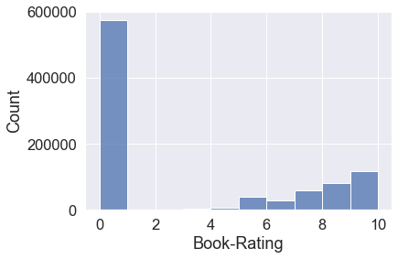
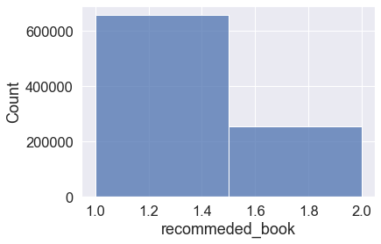
Metric For The System

Slide 7
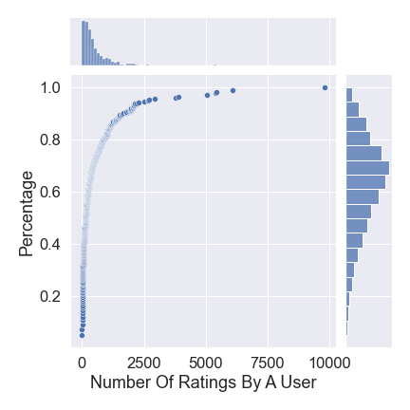
Number of Ratings By A User Percentage

Slide 8
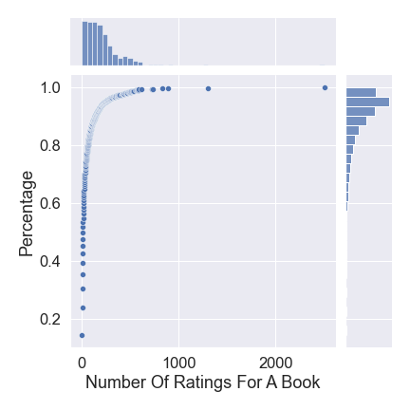
Number of Ratings For A Book Percentage

Slide 9
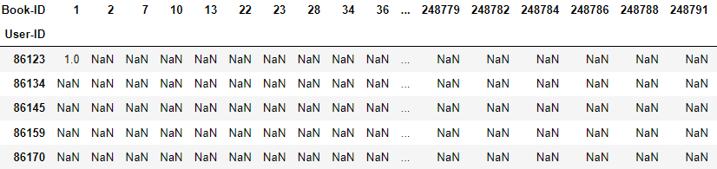
Collaborative Filtering
User-based collaborative filter is built on the idea that users with the same interests in the past also tend to buy and like similar items in the future.
Creating a Rating Matrix

Slide 10
Collaborative Filtering
Simple Mean:
Simplest Model
Use average recommendation across users
Weighted Mean :
Identify similar users with cosine score
Multiply recommendation with similar score before summing up
Advanced Method:
Use Machine Learning to identify user clusters
Surprise Scikit

Slide 11
Model Selection
Model:
Simple Mean
Weighted Mean
k-NN
k-NN Baseline
SVD
NMF
Co-Clustering
Metrics:
AUC
Accuracy
Precision

Slide 12
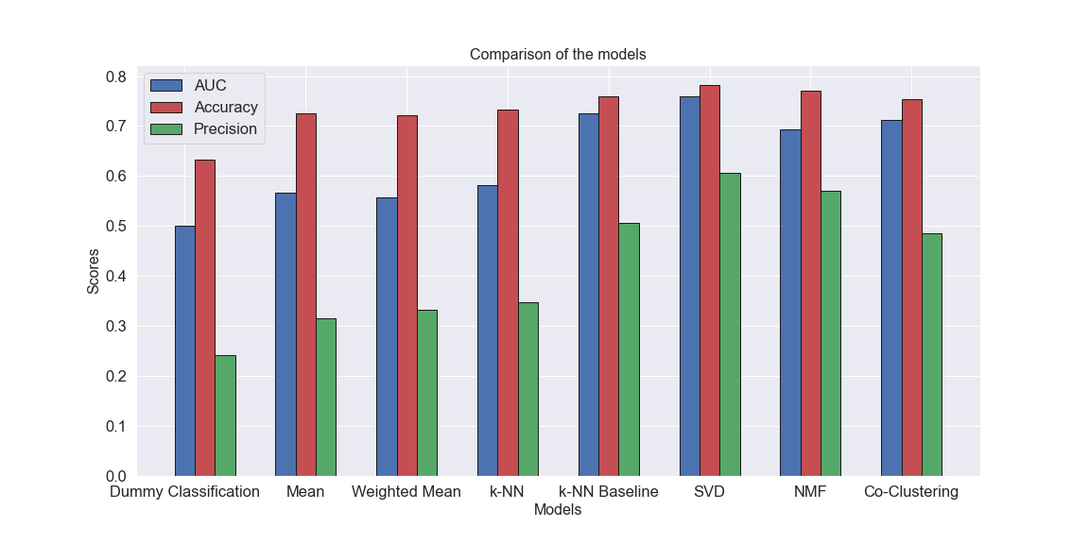
Model Performance

Slide 13
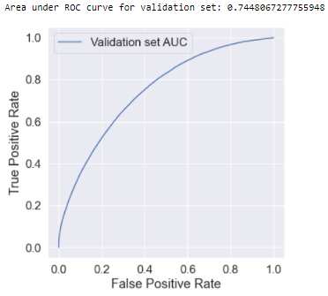
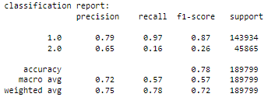
SVD Optimization
Grid Search Cross Validation
Precision as the primary metric

Slide 14
Conclusion
Build A Book Recommendation System Using Collaborative Filtering Based On Users
SVD is the best model in all three metrics: AUC, accuracy, and precision
The optimized SVD model gives an AUC of 0.74, an accuracy of 0.78, and a precision of 0.64
Compared to baseline model: an AUC of 0.5, an accuracy of 0.63, and a precision of 0.25

Slide 15
Future Direction
Collaborative Filtering in general suffers from Cold Start Problem
Solution: Develop Content-Based Recommendation System
Require more features such as summary, genre, etc. in our dataset
Combine content-based and collaborative-filtering to create a hybrid recommendation system

Slide 16
Thank You For Listening!

